Slide 1

Student Ambassador Projects
Tomato Disease Classifier
Notes:
Korrie

Slide 2
Tomato Disease Classifier
Team Matrix
Ridwan Abdurahman (Team Lead)
Notes:
Korrie

Slide 3
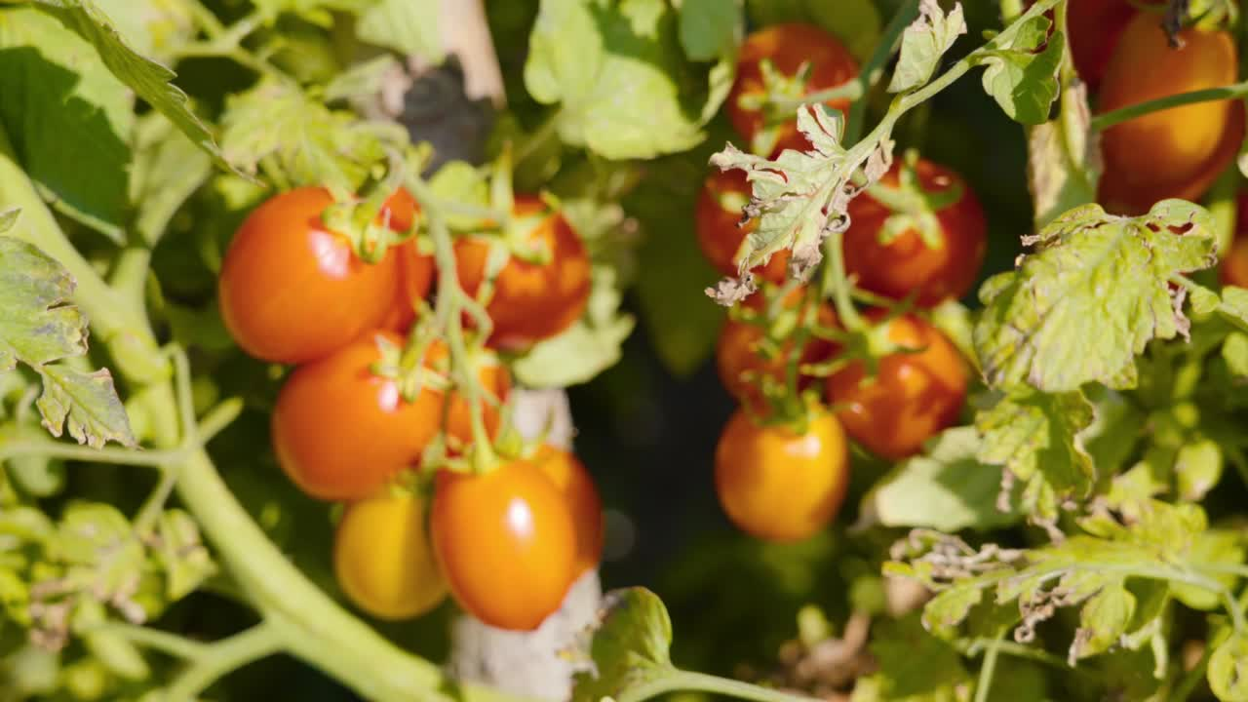
Introduction
Industry Trends & Pain Points
The agriculture industry faces several challenges including heavy reliance on manual inspections, inaccurate and delayed disease diagnosis, overuse of chemical treatments, and decreased crop yield and quality.
Why We Built It
We built this solution in response to the pressing need for more efficient and accurate methods of tomato disease detection in the agricultural industry. Traditional approaches were time-consuming, error-prone, and often led to significant crop losses. We saw an opportunity to leverage emerging technologies - machine learning, computer vision, and Azure OpenAI techniques to revolutionize disease management and empower farmers with real-time insights.
Notes:
Korrie
updated 7/21

Slide 4
Introduction
Powerful Customer Examples
Consider a small-scale tomato farmer who struggled with identifying diseases in their crops. With our solution, they were able to detect diseases early, apply targeted treatments, and significantly reduce crop losses. Another example is to consider that a large agricultural enterprise adopted our platform across multiple farms, resulting in streamlined operations, reduced reliance on chemical treatments, and improved sustainability practices.
Where We Fit In
While there are existing solutions in the agricultural technology space, our solution stands out for its combination of advanced machine learning, computer vision, and Azure OpenAI technology. We offer a comprehensive and integrated approach to disease management that is unmatched in the market.
Notes:
Korrie
updated 7/21

Slide 5




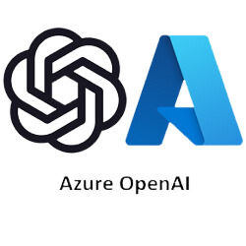

Technology
Custom Vision Model: Utilized Azure Custom Vision to classify images of tomato plants into different disease categories with high accuracy.
Web Application: Developed using Flask for the backend and HTML/CSS for the frontend, providing a user-friendly interface for image upload and disease prediction.
Azure OpenAI Service: Integrated to handle user queries about tomato diseases, offering informative and contextually relevant responses.
Azure Web App: Chosen as the deployment platform for hosting the web application, ensuring scalability and reliability.
Notes:
Korrie
updated 7/21

Slide 6
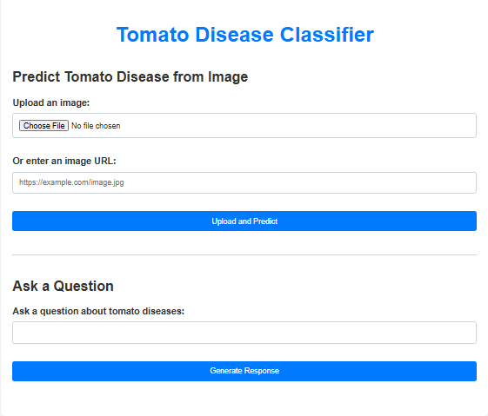
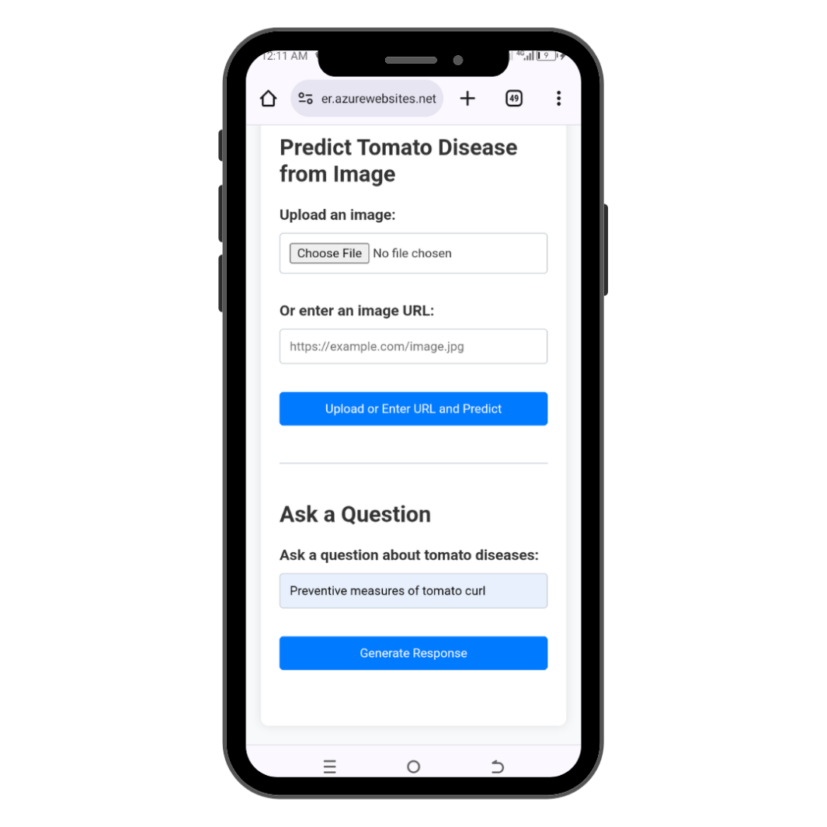
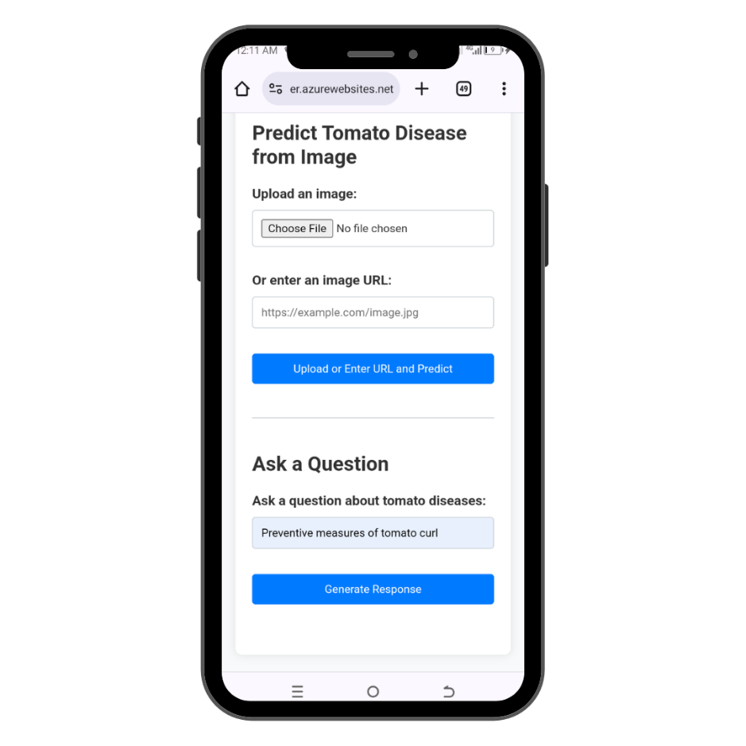
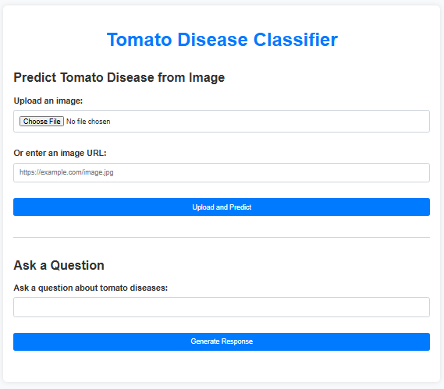
Demo
Tomato Disease Classifier Web App Interface

Slide 7
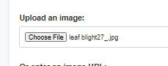
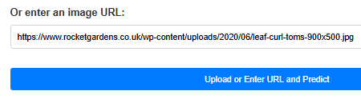
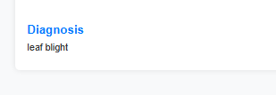
Demo
Identifying diseases through uploading an image and image url
Notes:
Korrie
updated 7/21

Slide 8
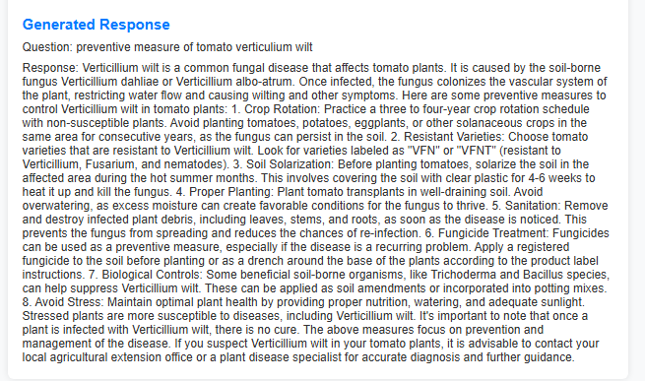
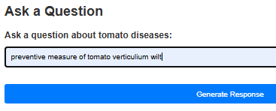
Demo
Generating Response
Notes:
Korrie
updated 7/21

Slide 9
Takeaways
Recommendations for the Audience: We recommend that our audience stop relying solely on traditional, manual methods of disease detection and embrace the power of technology to streamline their operations. Start leveraging advanced solutions like ours to optimize disease management and enhance crop health.
How Our Solution Speeds Up the Process: Our solution provides real-time insights and expert guidance, automating tasks and simplifying disease management for quicker decision-making by leveraging on Azure Custom Vision, Azure Web App, and Azure OpenAI Service technology.
Simplifying and Making It Cheaper: Our user-friendly platform centralizes disease detection, reducing the need for costly manual inspections and offering cost-effective alternatives to chemical treatments.
Notes:
Korrie
updated 7/21

Slide 10
Tomato Disease Classifier
https://tomatodiseaseclassifier.azurewebsites.net/
Thank You !!!
Notes:
Korrie

